Slide 1
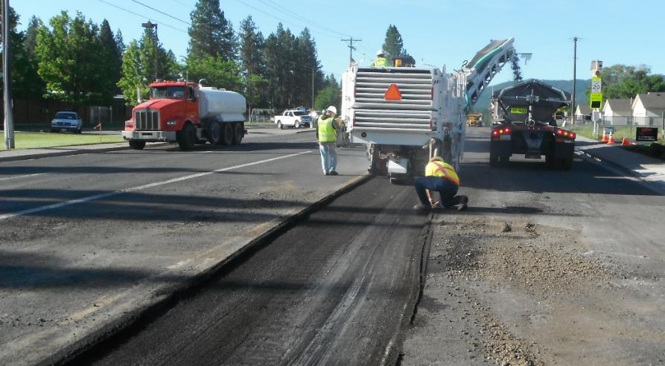

Video #2: Pavement Management Program (PMP) Review
Streets Sustainability Committee

Slide 2

Video Overview
Introduce
Introduce the City’s PMP
Discuss the elements of the PMP
Review
Review historical practices of the City’s PMP
Review
Review recent improvements to the City’s PMP
Distinguish between “preservation” and “maintenance”
2019 3rd-party review outcomes
Pavement condition data process

Slide 3
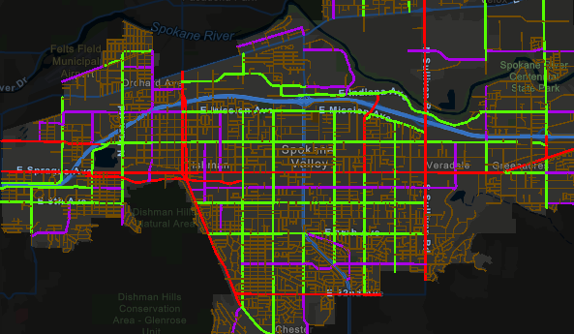
What makes up the City’s paved street network?
450 centerline miles
  128 Arterial/Collectors
  322 Local Access streets
1,000 total lane miles
1,900 acres of paved streets
  (8% of total City area)
Four Street Classifications:
  Principal Arterial
  Minor Arterial
  Collectors
  Local Access

Slide 4
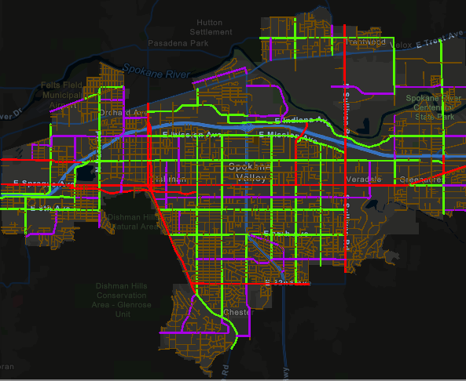
What makes up the City’s paved street network?
What’s the difference between Arterials/Collectors and Local Access?

Slide 5
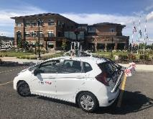
How should we care for our most expensive asset?
City Objectives, Policies & Budgets
Balanced
Approach
Priorities, Analysis Techniques & Reporting
Understanding of Condition

Slide 6
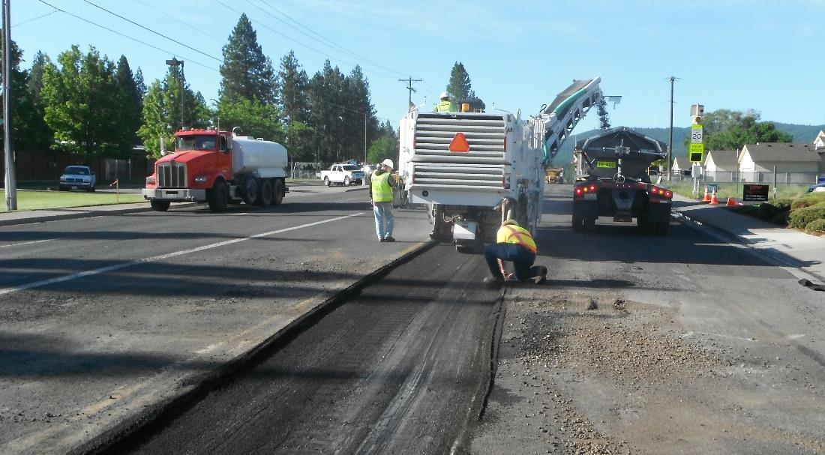
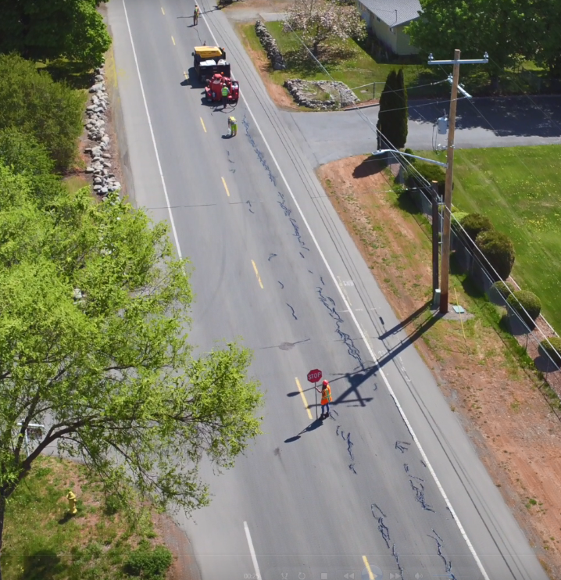
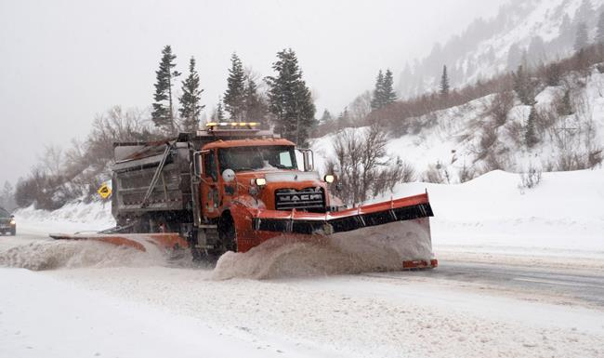
Part I: What is a Pavement Management Program?

Slide 7

What are the basic principles of pavement management?
Cost effective
Maximize resources
Keep roads in better condition for a longer time at a lower cost

Slide 8
What are the basic principles of pavement management?

Slide 9

So how does the PMP function in Spokane Valley?

Slide 10
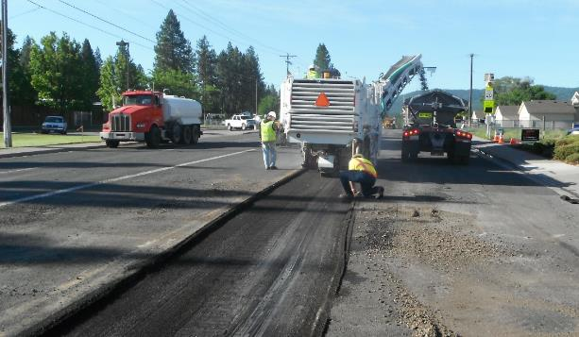
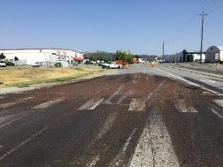
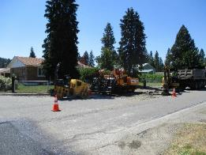
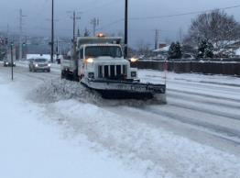
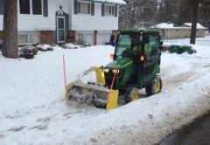
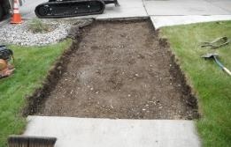
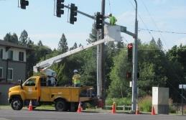
Two primary functions of the
Pavement Management Program
Preservation
The street surface you actually drive on
Seals, overlays, reconstruction
Planning for extending the life of the pavement
Maintenance
Everything else to make the street system work
Snow plowing, pothole repair, crack filling, signal and sign repair, street sweeping, sidewalk repair
Annual plans for system maintenance needed now

Slide 11

What does the PMP cost?
$16 million/year to keep the overall system in its existing “good” condition
(this is not what we actually spend)
Preservation
Annual preservation costs
$10 million
Maintenance
Annual maintenance costs
$6 million

Slide 12

How is this cost calculated?
Preservation
Value is based on a projection of future project costs needed for the paved streets to remain in their current condition
Maintenance
Value is based on historical costs for City to provide current level of service

Slide 13
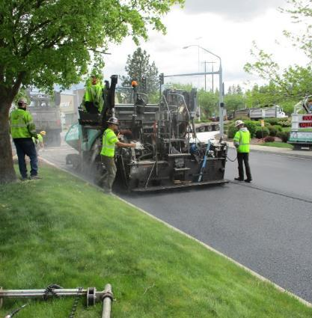
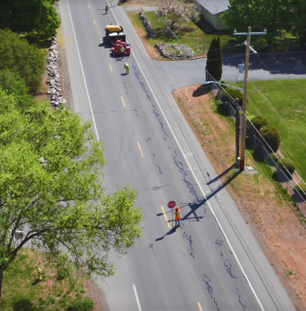
How does the community value these services?
Preservation
$10 M annually to keep pavement as-is
$5 M actual expended (historical avg.: $3 M local + $2 M grants)
  $5 M annual shortfall (Not covered. Services are reduced)
What services are provided?
Annual overlay and reconstruction projects
Pavement is aging faster than we can preserve it.
  Reduced services includes:
    Fewer projects
    Fewer treatment methods
$5 M/Yr is applied to asphalt preservation
Maintenance
$6 M annually to maintain existing services
$3 M dedicated funds
  $3 M annual shortfall (covered by reserve transfers)
  What services are provided?
  Snow and ice control
  Pavement repairs: potholes, patches, crack fill, sidewalks
  Traffic signals and signs
  Street lighting
  Street sweeping & vegetation control
$1M/Yr is applied to asphalt maintenance

Slide 14
How does the community value these services?
$8 M annually budgeted to the Pavement Management Program
-16 M annual cost to maintain paved street network (Good PCI of 76)
= $8 M funding shortfall
Increase PMP budget to keep our roads in their current condition, OR
Reduce services to fit within available budget.

Slide 15


Part II: Historical practices of the City’s PMP

Slide 16

The City’s PMP Funding Roadmap
2004
Proposed utility tax discussion does not move forward
2006/2007
City conducts its 1st condition survey-Street Master Plan
2008
Telephone utility tax approved and effective in 2009
2011
Preservation Fund #311 created
2012
2011 PMP adopted & General Fund transfers used for preservation Projects
2013
Civic Facility Replacement Fund #123 transfers $2.3 Million into Fund #311 over 4 years
2014
Council sets goal for a sustainable PMP (recurring thru 2021)
2016
Proposed utility tax discussion does not move forward
2018
Solid Waste Collection Fee for Local Access streets
2019
3rd Party PMP review, New survey contract
2020
2019 condition survey results, action items, & improvements
2021
Streets Sustainability Committee
2003 Incorporation

Slide 17

How did the 2019 3rd-party review affect where we are today?
Overall, the City’s PMP is satisfactory, but improvements were suggested:
Improve software capabilities and data collection frequency
Identify pavement condition targets
Identify revenue to achieve targets
Engage the community

Slide 18
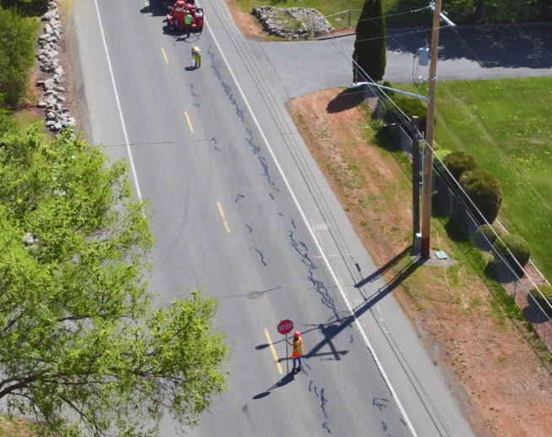
How have City surveys progressed over time?

Slide 19
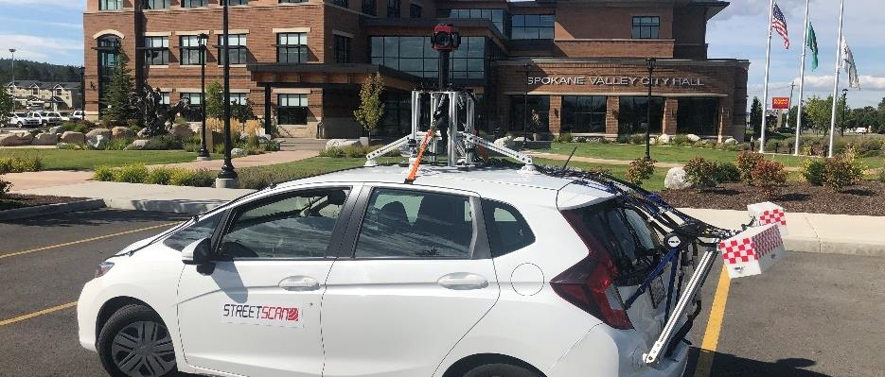

City Surveys
Pavement condition assessments every 2-3 years since 2006
Manual/walking (2007, 2009)
Semi-automated (2011, 2013, 2016, 2018)
Fully-automated (2019)
Incremental improvements over time
Improved condition assessments
Consistent, reliable
Improved software
User-friendly

Slide 20
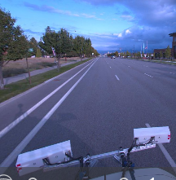
What is a pavement condition survey?

Slide 21
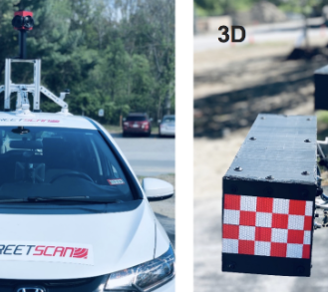
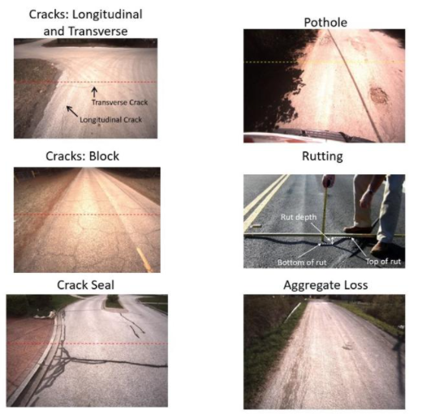
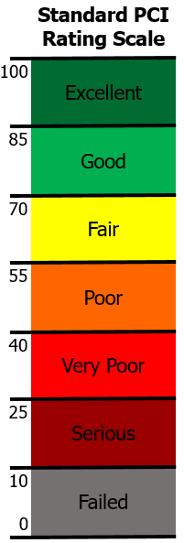
Pavement Condition Survey
Survey 100% of City streets every 3 years
  Arterials & Collectors get two “passes”
  Local Access streets get one “pass”
StreetScan collects & computes road condition

Slide 22
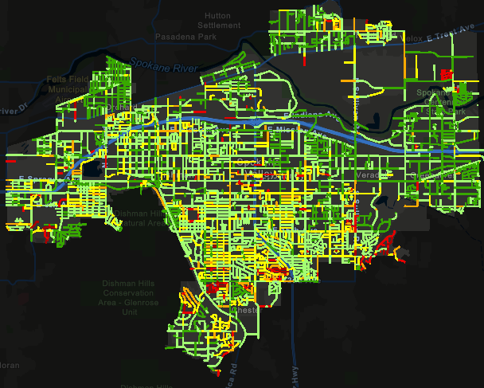
How does the City measure up?

Slide 23
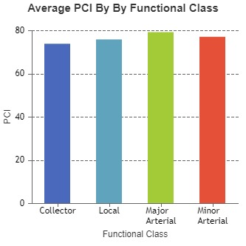
PCI: Pavement Condition Index
PCI: Pavement Condition Index
Network average score: 76
79
77
74
76

Slide 24
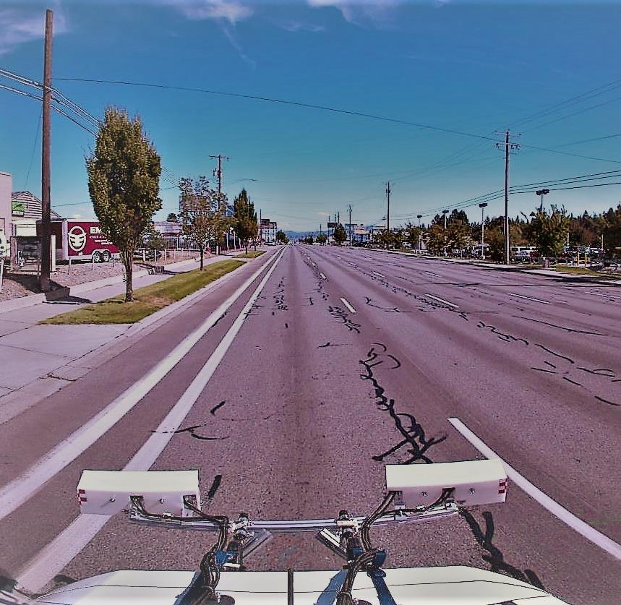
How can we plan for preservation?

Slide 25
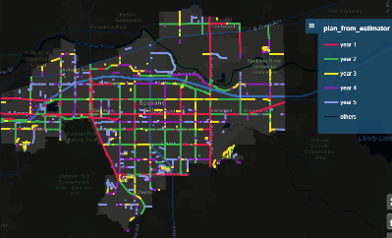
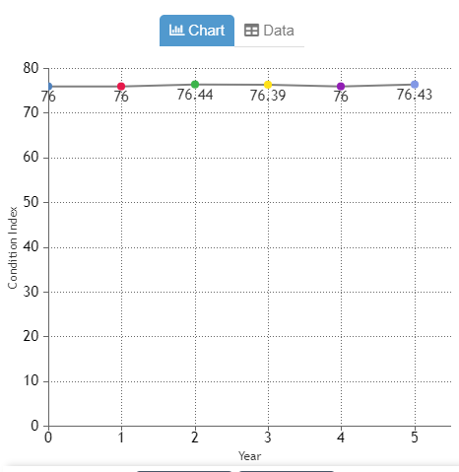
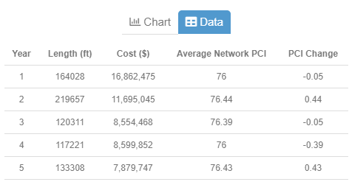
PMP Software: Software supports decision making
Scenario & budget planning
  Plan for a target PCI
    Get the applicable budget as a result
  Plan for a target budget
    Get the applicable PCI as a result
  Set priorities by:
    Street functional class
    Asphalt repair type
    Number of years
    Location

Slide 26
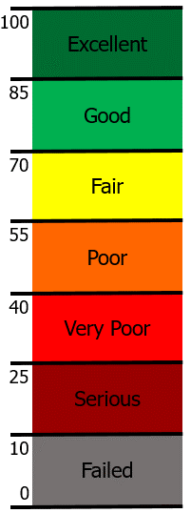

How do costs impact the setting of your
Pavement Condition Target?
More $$$
Preservation: $10 Mil/Yr
Maintenance: $6 Mil/Yr
Total: $16 Mil/Yr
Should we use surface treatments on our streets?
Less $
Should my residential street get the same priority as our busiest streets?
Should we make our pavements better, worse, or keep them the same?

Slide 27

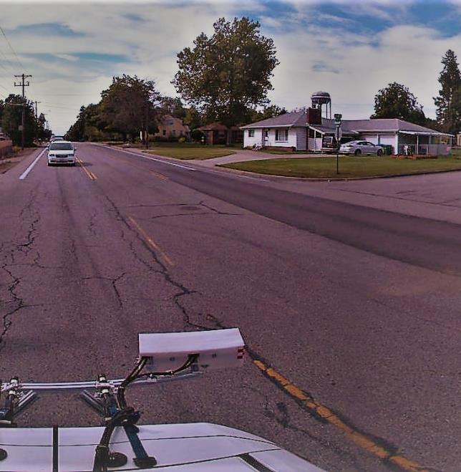
Key Considerations
What long-term pavement “condition” should we plan for?
Which type of pavement “repairs” are acceptable?
Which program services should be prioritized?

Slide 28
Streets Sustainability Committee
For more information:
https://www.spokanevalley.org/StreetsCommittee
Adam Jackson, Pavement Management Program Coordinator
509-720-5024
Ajackson@SpokaneValley.org
StreetSolutions@SpokaneValley.org

