Slide 1
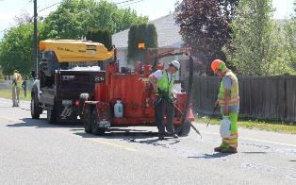
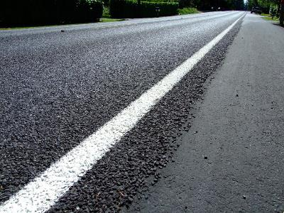
Videos 1, 2, & 3: Review
By the end of Videos 1, 2, and 3, we want to be able to answer:
What long-term pavement condition should we plan for?
Which type of pavement “treatments” or “repairs” are acceptable?
Should we use surface treatments?
Which program services should be prioritized?
Should arterials/collectors be prioritized differently than local access streets?

Slide 2
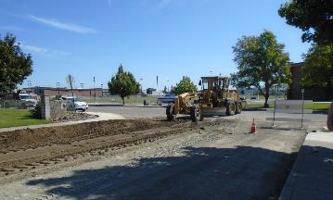
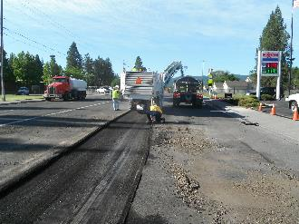
Video #3: Pavement Goals & Methods of Repair
Streets Sustainability Committee

Slide 3

Video #3 Overview
Discuss
Discuss the different pavement condition ranges
Review
Review different “treatment” or “repair” methods (historical & future)
Lower cost treatments with shorter life-cycles versus
Higher cost treatments with longer life-cycles
Review
Review how pavement condition & treatment types affect cost

Slide 4
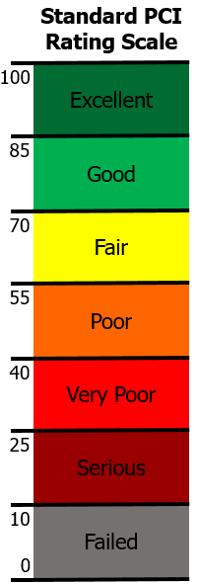
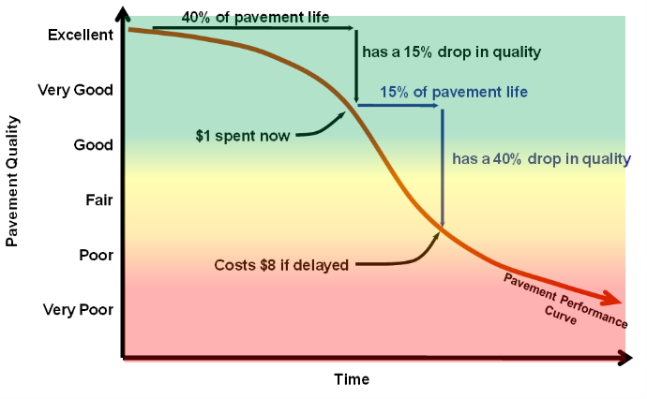
As we review examples, a few considerations:
Not all conditions age at the same rate
PMP principle: its cheaper to maintain than to rebuild
Slower aging & deterioration
Today
Faster aging & deterioration
Slower aging & deterioration

Slide 5
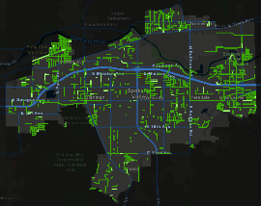
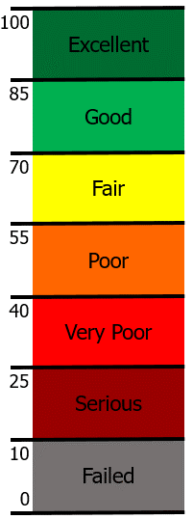
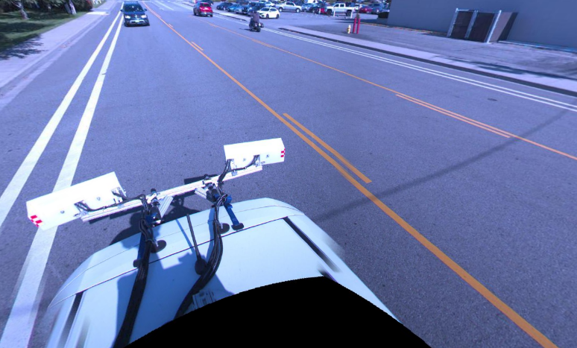
Pavement condition examples: What’s an acceptable pavement condition?
McDonald Road (South of Sprague Ave.)
PCI Range 85-100
Minimal surface defects: negligible crack fill/longitudinal cracks/utility patches.
Road Age: 6 years old (2015 Reconstruction Project)

Slide 6
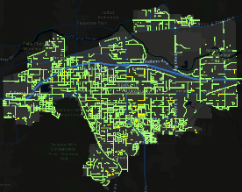
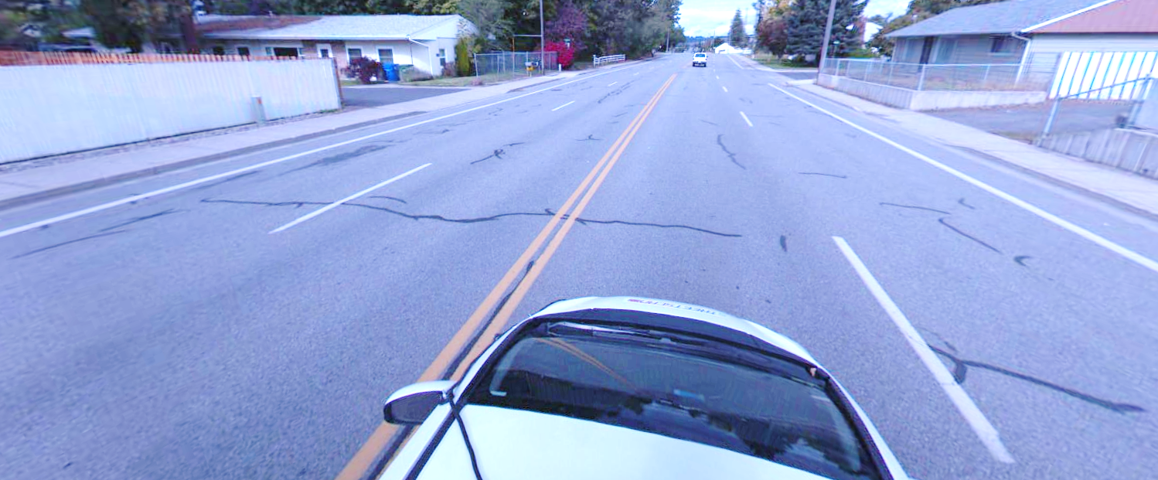
Pavement condition examples: What’s an acceptable pavement condition?
University Road (Between 8th & 16th Ave.)
PCI Range 75-80
Noticeable surface cracking (crack fill), negligible bumps/depressions
Road Age: 9 years old (2012 Overlay Project)

Slide 7
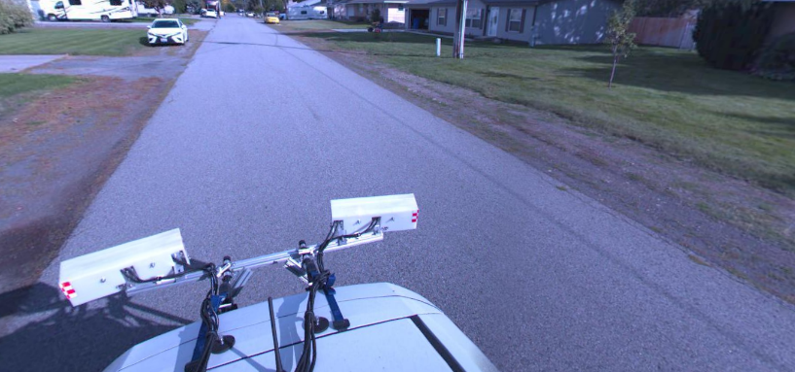
Pavement condition examples: What’s an acceptable pavement condition?
Alki Ave (Between Best Rd and Adams Rd.)
PCI Range 75-80
Surface weathering, edge cracking at shoulder, occasional longitudinal cracking/bumps
Road Age: 15 years old (2006 Sewering Project)

Slide 8
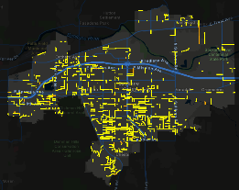
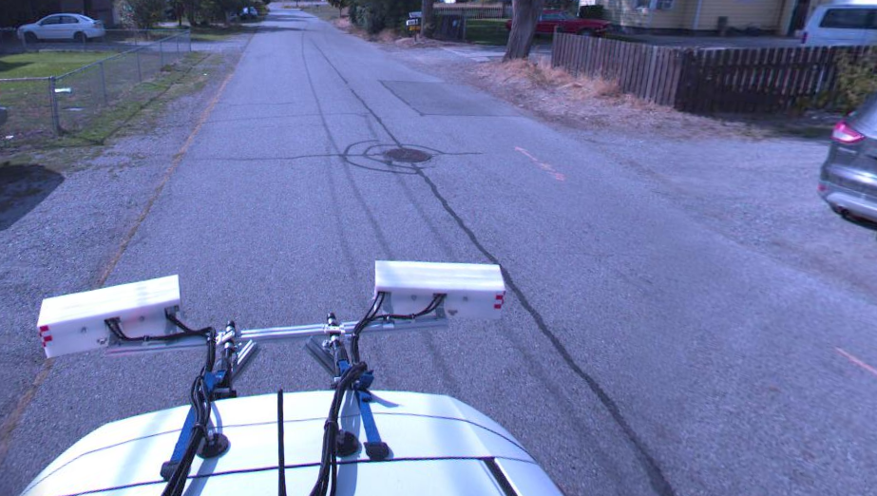
Pavement condition examples: What’s an acceptable pavement condition?
Grace Ave. (Between University Rd. and Bowdish Rd.)
PCI Range 65-70
Longitudinal cracking and occasional transverse cracking, early settling at manhole will lead to local failures (blow-outs leading to potholes), edge cracking at shoulder, utility patching
Road Age: 24 years old (1997 Sewering Project)

Slide 9
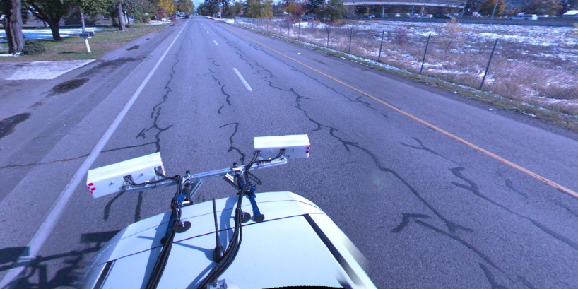
Pavement condition examples: What’s an acceptable pavement condition?
3rd Avenue (Between Havana Rd. & Carnahan Rd.)
PCI Range 60-65
Extensive surface cracking (see longitudinal wheel path cracks), measurable local failures like rutting or potholes and patches, susceptible to freeze/thaw damage
Road Age: 19 years old (2002 Sewering Project)

Slide 10
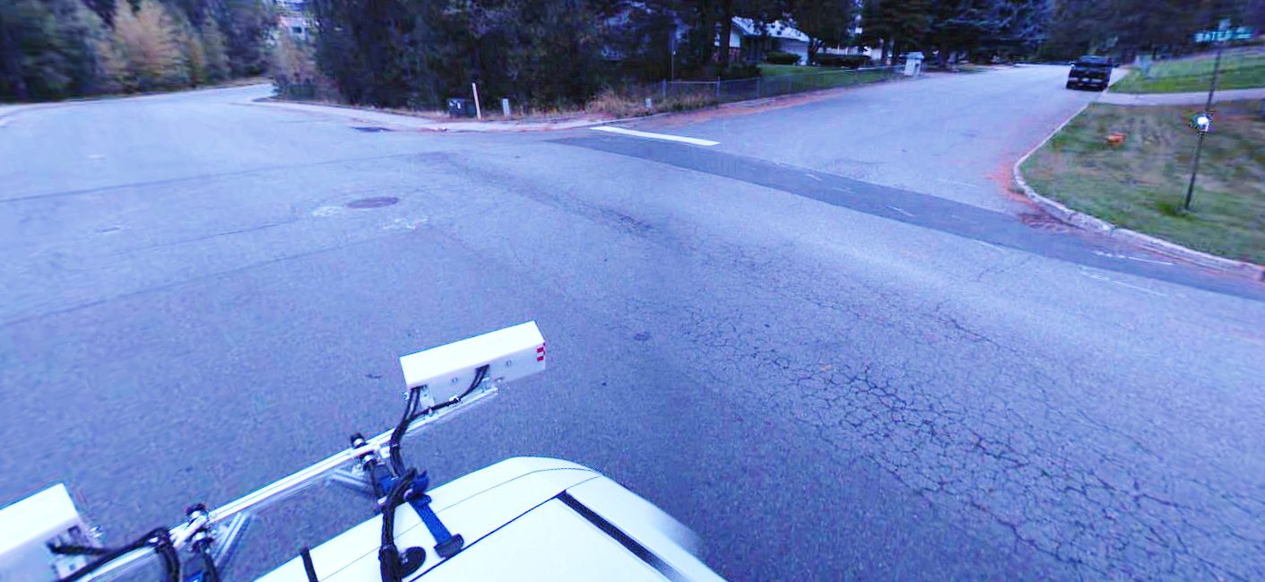
Pavement condition examples: What’s an acceptable pavement condition?
Intersection of Ponderosa & Bates
PCI Range 55-60
Areas of asphalt failure (alligatored cracking), measurable local failures like sunken/failed manhole patches (bumps), multiple utility patches, susceptible to freeze/thaw damage
Road Age: 21 years old (2000 Sewering Project)

Slide 11
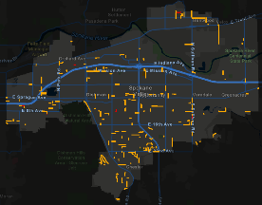
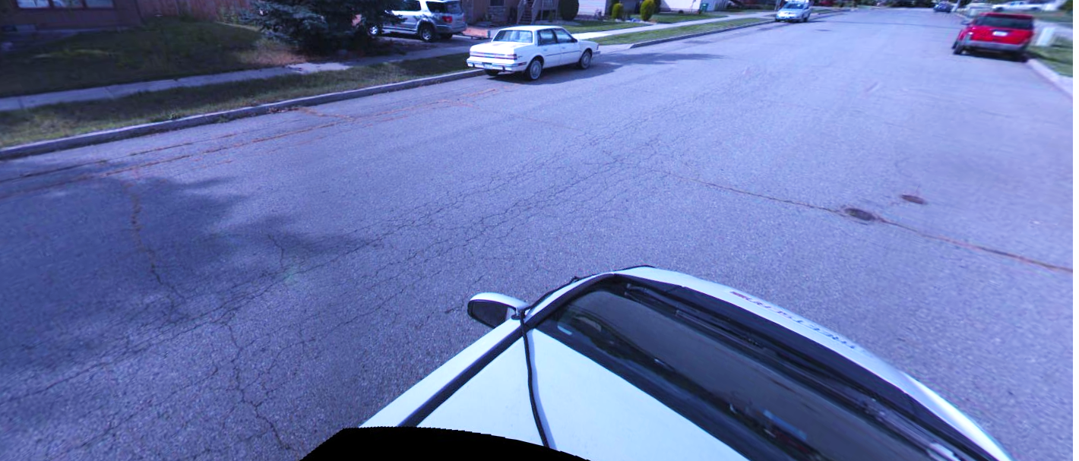
Pavement condition examples: What’s an acceptable pavement condition?
Calvin Rd. (North of Wellesley Ave.)
PCI Range 45-50
Extensive surface (alligatored) cracking, measurable local failures: failed utility trench patches (bumps), longitudinal and transverse cracks, susceptible to freeze/thaw damage
Road Age: 36 years old (1985 Residential Development)

Slide 12
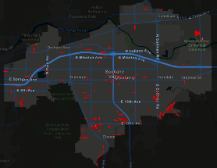
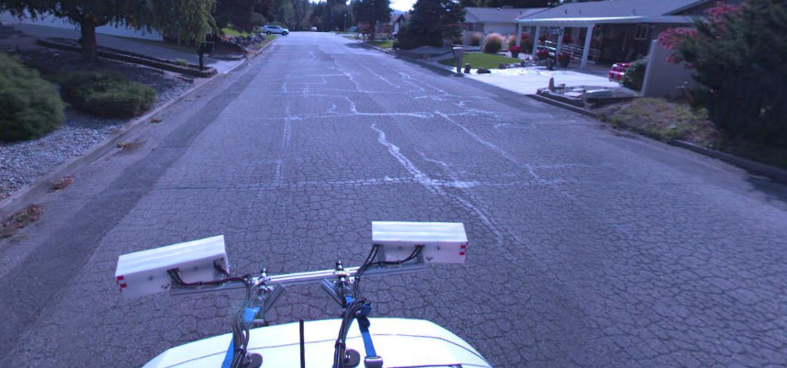
Pavement condition examples: What’s an acceptable pavement condition?
Vera Crest Dr. (North of 24th Ave.)
PCI Range 20-25
Complete pavement failure: full width alligatored cracking, extensive patching, extensive pothole repair (bumps), susceptible to freeze/thaw damage
Road Age: 30 years old (1991 Residential Development)

Slide 13
Which pavement “treatments” or “repairs” are considered?

Slide 14
Which pavement “treatments” or “repairs” are considered?
Methods for maintaining our streets
Preventative maintenance
Spot repair, patching, crack seal
Surface Treatments
Most effective on locals/collectors
Rehabilitation
Grind/Overlay street surface
Reconstruction
Remove/Replace street
Current practice

Slide 15
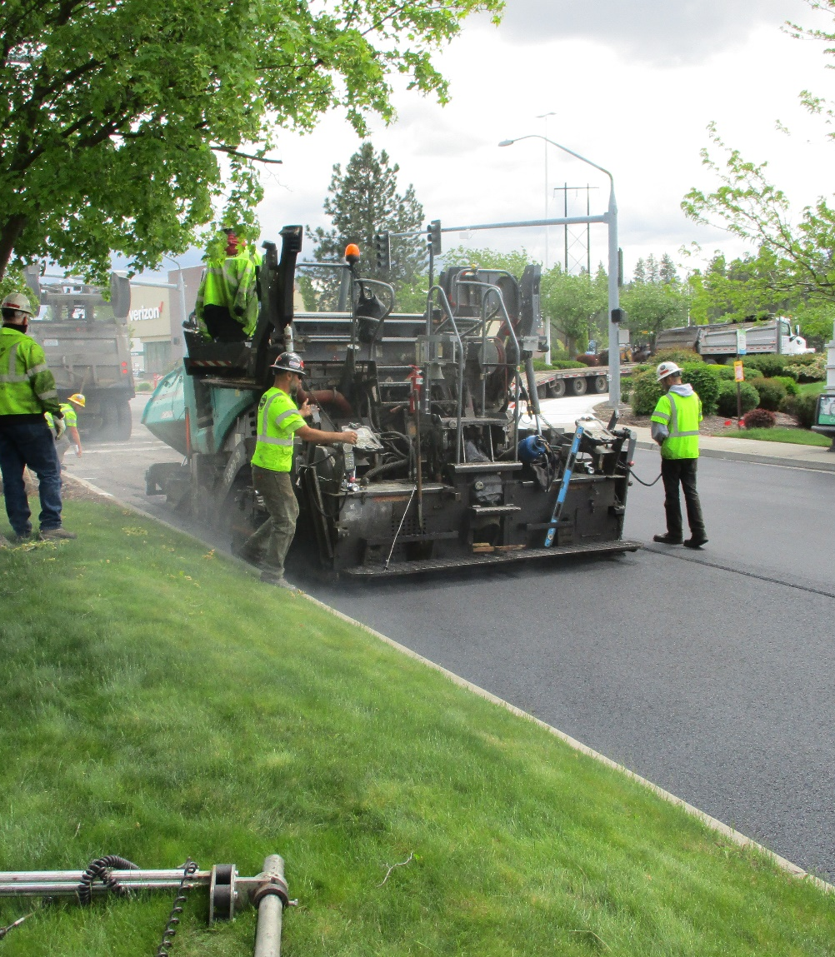
How can surface treatments help?

Slide 16

Surface Treatments
Typically work well on “good” condition roads
Slows aging = longer life = save money
Easy to implement
New wearing surface for traffic
Protects the street against:
Weathering
Surface cracking
Prevents potholes
Concerns:
Longevity
Availability
Public acceptance
$30-80/SY
Rehabs & Rebuilds
$5-10/SY
Surface Treatments

Slide 17
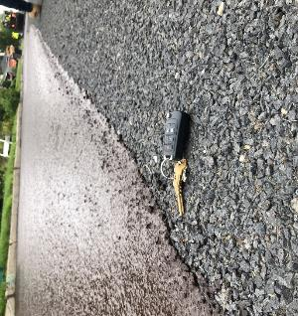
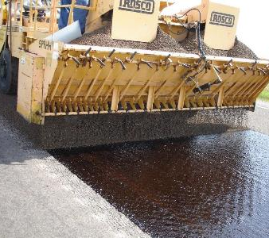
Which surface treatments have been used in our region?
Fog Seals
Chip Seals
Slurry Seals & Microsurfacing
Thin overlays

Slide 18

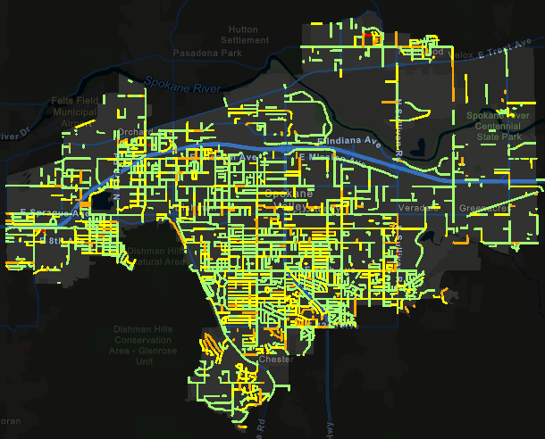
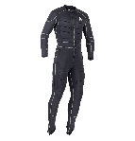

How can surface treatments help?
$
Sunscreens and moisturizers
Fog seals
Rejuvenators
Padded layers = extra protection
Chip seals
Slurry seals
Microsurfacing
Full body armor
Double chip seals
Combo seals (from above)
Thin overlays
Intensity & Cost
$$$$
All streets with PCI 40-80 that may be considered for surface treatments.

Slide 19
How do pavement condition and available “treatment” methods impact long-term costs for the PMP?
More $$$
Preservation: $10 Mil/Yr
Maintenance: $6 Mil/Yr
Total: $16 Mil/Yr
Less $

Slide 20
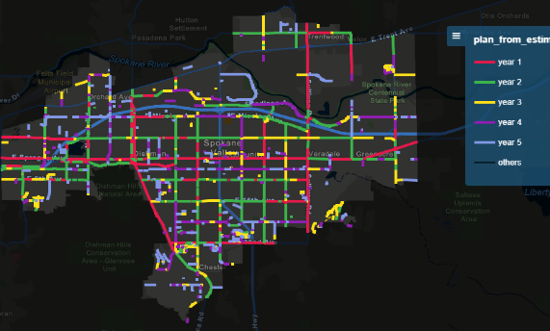
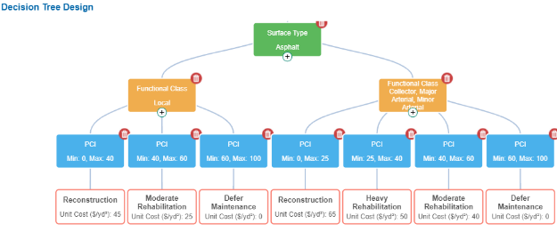
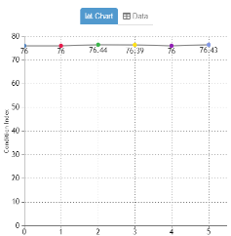
Available resources determine available options
What is the condition of the pavement?
What is the best “treatment” to extend the pavement life most effectively?
What is our condition goal and available budget?
Which streets should be prioritized to maximize benefit?
Prioritized project list generated

Slide 21

How far can our dollars take us?

Slide 22
How far can our dollars take us?
Budget for Constant PCI ($6.5 M/Yr)
Today’s Budget
($1.5-2.0 M/Yr)
Regardless of reduced budget amount, it takes at least $6.5 M/Yr to stop the decline.
Notes:
-Each PCI point costs about $300,000: $6.5-2 = 4.5M, 76-62=14. 4,500,000/14=$321,428 per PCI point
-There is nuance with dollar projections and PCI impacts because we spend 101 funds on specific patches

Slide 23
How far can our dollars take us?
Today’s Budget =
Budget for Constant PCI
($3.5-4.0 M/Yr)
On average, the City has expended funds to maintain its arterial and collector streets in their current condition.

Slide 24

How to fund the PMP to reflect our priorities?

Slide 25
How to fund the PMP to reflect our priorities?
More $
Asphalt Preservation
Cost to keep existing condition: $10 M/Yr
Locals $6.5 M/Yr
Arterials/Collectors: $3.5 M/Yr
$5 M/Yr dedicated funds
$3 M/Yr local funds + $2 M/Yr grant funds
$5 M/Yr annual shortfall covered by reducing services
Street Maintenance
Cost to maintain existing services: $6 M/Yr
$3 M/Yr dedicated funds
$3 M/Yr annual shortfall covered by reserves
Preservation: $10 Mil/Yr
Maintenance: $6 Mil/Yr
Total: $16 Mil/Yr
Less $

Slide 26
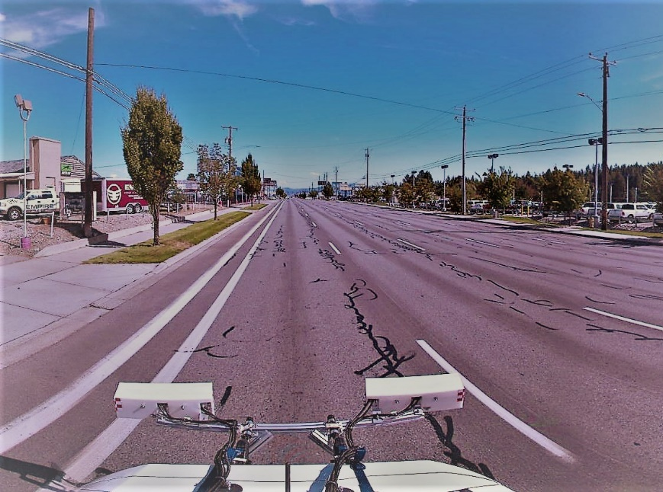

Key Considerations
Videos 1, 2, and 3 have provided the background info to consider the following:
What long-term pavement condition should we plan for?
Which type of pavement “treatments” or “repairs” are acceptable?
Should we use surface treatments?
Which program services should be prioritized?
Should arterials/collectors be prioritized differently than local access streets?

Slide 27

Streets Sustainability Committee
For more information:
https://www.spokanevalley.org/StreetsCommittee
Adam Jackson, Pavement Management Program Coordinator
509-720-5024
Ajackson@SpokaneValley.org
StreetSolutions@SpokaneValley.org

