Slide 1
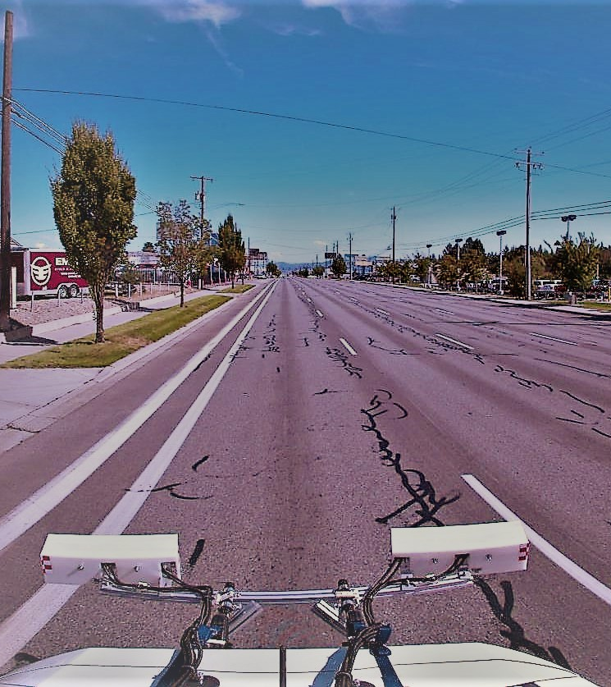
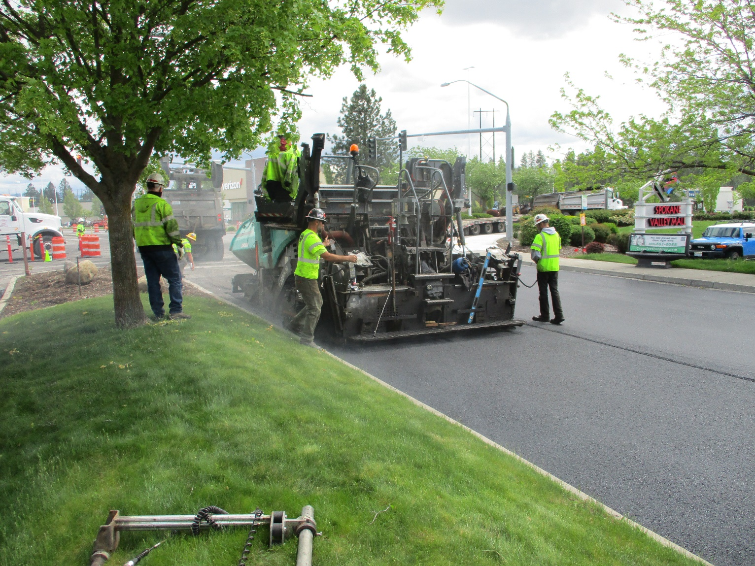

Street Sustainability Committee
Video 1: Introductions & Committee Overview

Slide 2

Why are we doing this?

Slide 3

City has yet to extensively seek public opinion
How does the community value our paved street network?
What pavement condition is good enough and what repair methods should be used?
How can we pay for it?

Slide 4

Why are we doing this?
How do we effectively gather public input?
Have other agencies done this before?
City reached out to learn how other municipalities conducted public outreach
  Consensus: Form a committee

Slide 5
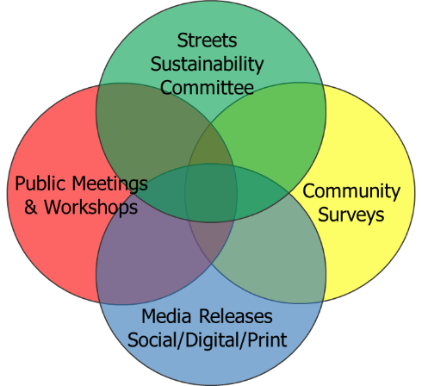
What are the committee’s goals?

Slide 6

3 Main Goals
Evaluate
Evaluate citizens’ interest and support for maintaining city streets and suggesting pavement condition goals.
Seek public feedback
Identify
Identify preference for maintaining city streets, types of treatments used, and long-term levels of service.
Identify pavement condition targets
Investigate
Investigate current revenues and potential future funding sources for maintaining city streets at the recommended level of service.
Investigate funding needs and sources

Slide 7

Who are the committee members?

Slide 8
23 Committee Members
Community stakeholders representing a variety of sectors
Confirmed by City Council on March 23, 2021
Name | Category | Employer
Cheryl Stewart | Business – General | Assoc. of General Contractors – Inland NW
Lance Beck | Business – General | Greater Spokane Valley Chamber of Commerce
Frank Tombari | Business – General | Banner Bank
Kevin Person | Business – Large | Wagstaff
Kyle England | Business – Large | Kaiser Aluminum
Greg Repetti | Business – Large | Valley Hospital
Jesse Granado | Business – Large | Waste Management
Robin DeRuew | Business – Small | Fitness Fanatics
Tom Dingus | Business – Small | Dingus, Zarecor & Associates, PLLC
Matt Ewers | Freight | Inland Empire Distribution Services
Chris Moan | Citizen Representative
Diana Wilhite | Citizen Representative
Kathe Williams | Citizen Representative
Ben Small | Schools | Central Valley School District
Cal Coblentz | Social Services | Spokane Valley Partners
Carol Weltz | Social Services | Spokane Neighborhood Action Partners (SNAP)
Mike Frucci | Transportation | Washington State Dept. of Transportation
Karl Otterstrom | Transportation | Spokane Transit Authority
Kelly Fukai | Transportation | Washington State Transportation Commission
Kevin Wallace | Transportation | Spokane Regional Transportation Council
Joe Tortorelli | Transportation | Spokane Good Roads Association
Melanie Rose | Utility Company | Avista Utilities
Todd Henry | Utility Company | Vera Water and Power

Slide 9
Who is on the City’s staff team?

Slide 10
City Staff Team
Adam Jackson, Pavement Management Program Coordinator
  Lead Point of Contact
  509-720-5024
  Ajackson@SpokaneValley.org
  StreetSolutions@SpokaneValley.org
Bill Helbig, City Engineer
Chelsie Taylor, Finance Director
John Hohman, Deputy City Manager
Dr. Linda Pierce, Subject Matter Expert – Nichols Consulting Engineers
Dr. Joy York, Facilitator

Slide 11

What is the committee’s schedule?

Slide 12
Committee Schedule
Committee Meetings
Public Outreach Campaign
Public Workshops
City Council
Today
Apr
May
Jun
Jul
Aug
Sept
Oct
Nov
Dec

Slide 13

What topics will be discussed?

Slide 14
Committee Meeting Topics
April
Introductions & Overview
May
Assumptions and expectations for Spokane Valley streets
June
Funding preferences for Spokane Valley streets
July
Properly engaging the community to solicit feedback
August
Public input and draft committee findings
September
Summary of findings

Slide 15

What about committee outcomes?

Slide 16
Members will share their perspective and reach out to their respective base to facilitate community involvement & answer the following:
What long-term pavement “condition” should we plan for?
Which type of pavement “treatments” or “repairs” are acceptable?
Which program services should be prioritized?
How would you fund the Pavement Management Program?
How would you inform the public and gather their input?

Slide 17
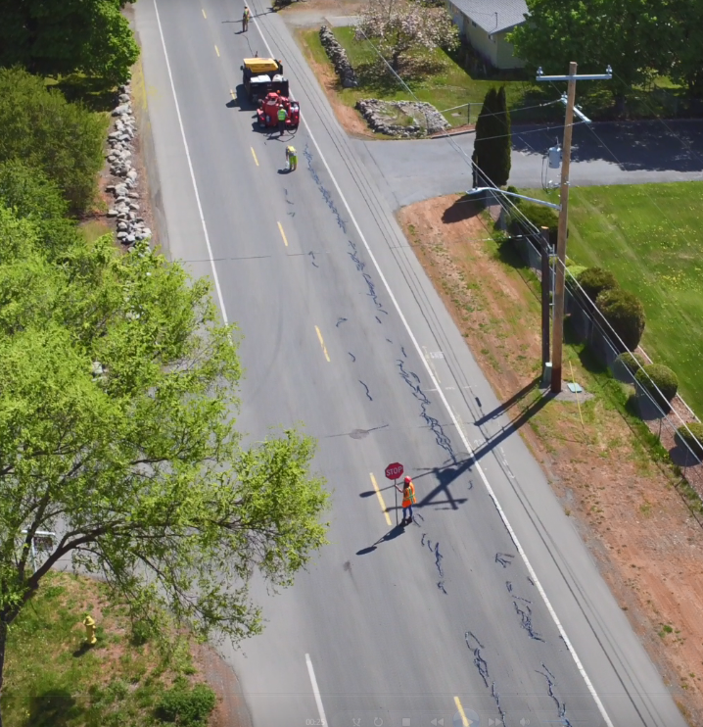
What’s next?

Slide 18
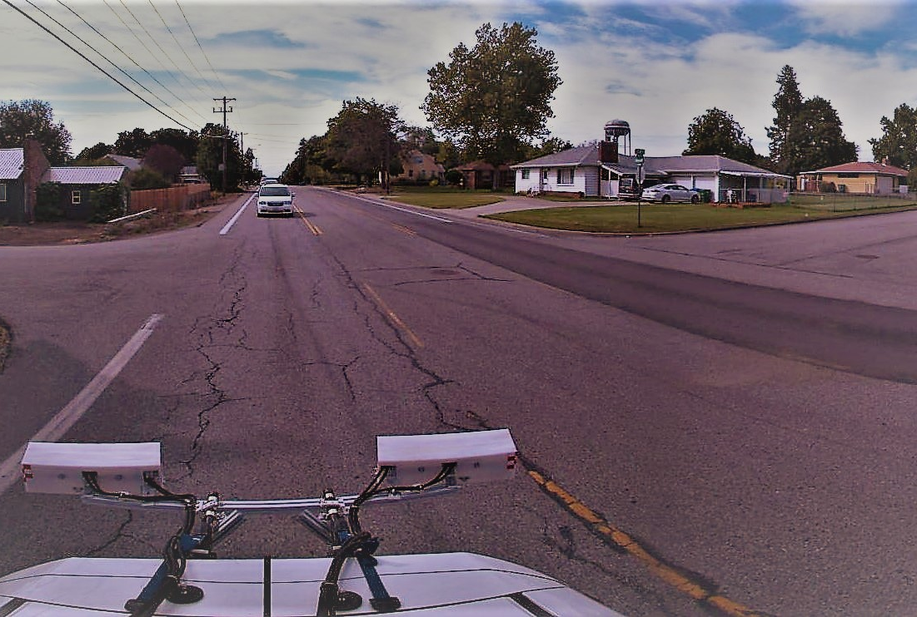
Review Materials
Video 2 – Review of the City’s Pavement Management Program
Video 3 – Pavement Goals & Methods of Repair

Slide 19
Streets Sustainability Committee
For more information:
https://www.spokanevalley.org/StreetsCommittee
Adam Jackson, Pavement Management Program Coordinator
509-720-5024
Ajackson@SpokaneValley.org
StreetSolutions@SpokaneValley.org

