Slide 1
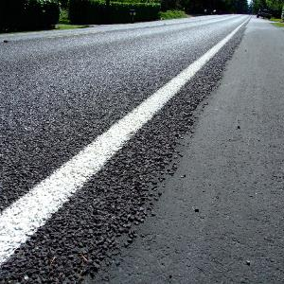

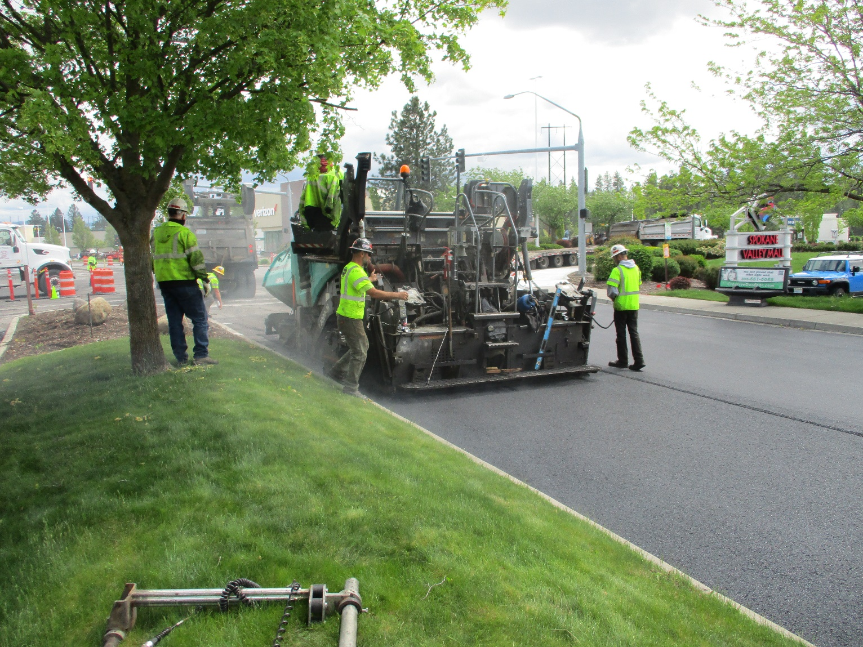
Video #4: History of
Pavement Management Program Funding
Streets Sustainability Committee

Slide 2

What is a Fund and why do we need to know?

Slide 3
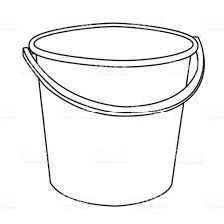
Funds are the building blocks of governmental accounting.
Each fund has a distinct purpose with separate revenue sources and allowed expenditures.
The Pavement Management Program is operated using three separate Funds.
Revenues
Expenditures
Fund
Notes:
Funds are the building blocks of governmental accounting. We are required by accounting rules to use Funds to account for the City’s finances. The City has 25 separate Funds.
The reason that a new fund is created is generally because there is a distinct revenue source, and that revenue source is restricted in some way so that it may only be used for a specific purpose.
Each Fund can be thought of as a separate bucket with revenues coming in and expenditures coming out.
The Pavement Management Program is operated using three separate Funds.

Slide 4
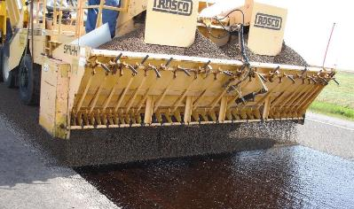
Which Funds are used in the
Pavement Management Program?

Slide 5
The City uses three separate Funds for the
Pavement Management Program.
Each Fund has its own unique challenges.
Notes:
The three funds used in the Pavement Management Program are the Street O&M Fund #101, the Street Capital Projects Fund #303, and the Pavement Preservation Fund #311.
This chart is a good general summary of the revenues in each of these funds as well as the expenditures paid out of each.
Each of these three Funds have some unique challenges that I will discuss momentarily.

Slide 6

What are the challenges in the Street O&M Fund #101?

Slide 7
The main challenge in the Street O&M Fund #101 is declining revenues that no longer support the cost of services.
The amended 2021 budget includes estimated revenues of $3 million and expenditures of $5.6 million for a operating deficit of $2.6 million.
Services Provided by Fund #101:
Snow and ice control
Pavement repairs: potholes, patches, crack fill, sidewalks
Traffic signals and signs
Street lighting
Street sweeping & vegetation control
There are two main revenue sources in Fund #101:
Telephone Utility Tax
Motor Vehicle Fuel (Gas) Tax
The deficit is currently being filled with transfers from the General Fund.

Slide 8
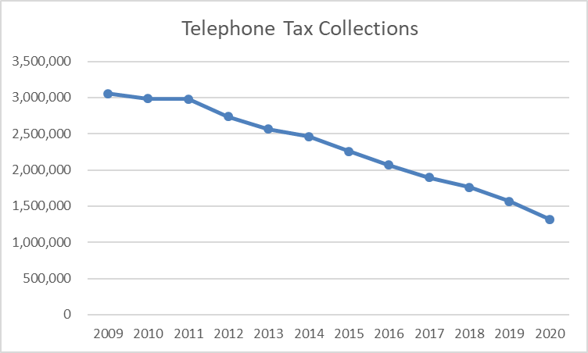
The Telephone Utility Tax is a 6% utility tax on telephone business within the City.
Activity for both landlines and cell phones are taxable.
Revenue collections for this tax peaked at about $3.1 million in 2009 when the tax was implemented.
Collections have fallen at an average annual rate of 6.76% since 2009, and 2020 collections were just $1.3 million.
Telephone Tax

Slide 9
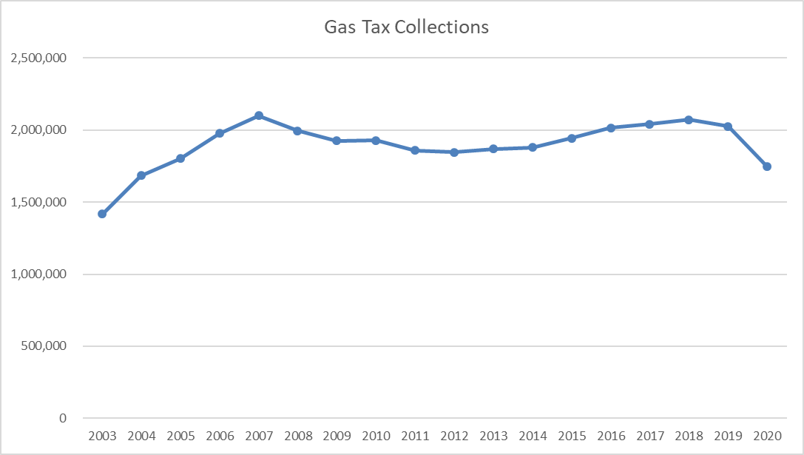
Gas Tax
The Gas Tax is imposed at the State level and is based on the number of gallons sold.
This has been declining gradually due to having more vehicles on the road with higher fuel efficiency.
The City collects about $2 million annually from this tax.

Slide 10

What are the challenges in the Street Capital Projects Fund #303?

Slide 11
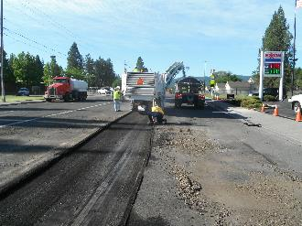
The main challenge in the Street Capital Projects Fund #303 is in accumulating adequate funding to complete largescale projects.
The amended 2021 budget includes $8.9 million in street construction and reconstruction projects.
These projects are generally funded through State and Federal grants along with City matching funds.
Matching funds come from two main sources:
  Real Estate Excise Taxes
  Transfers from the Capital Reserve Fund #312. This source could become limited if the City continues to fund the Street O&M Fund #101 operating deficits with the General Fund.

Slide 12
Real Estate Excise Taxes (REET)
Real Estate Excise Taxes (REET) consist of 0.5% of real estate sales within the City.
The use of REET funding is limited by State law to capital projects in the City’s Transportation Improvement Plan.
The City has been allocating more and more REET revenues toward grind and overlay projects in the Pavement Preservation Fund #311 in recent years.
  This could eventually limit the City’s ability to match grant funded construction/reconstruction projects in Fund #303.

Slide 13
What are the challenges in the Pavement Preservation Fund #311?

Slide 14
The main challenge in the Pavement Preservation Fund #311 is funding projects at a level that will maintain the City’s streets at their current condition.
The amended 2021 budget includes $4.7 million in grind and overlay projects.
These projects are funded through transfers from other City Funds as well as State and Federal grants.
In 2013, the City committed to transferring an amount equal to 6% of recurring General Fund expenditures to Fund #311.
  These transfers have been from the General Fund, the Street O&M Fund #101, the Civic Facilities Replacement Fund #123, and REET funds.
  Fund #123 was depleted completely after 2016.
  Fund #101 transfers were discontinued in 2018.
  REET funds have increased to fill the hole left by Funds #123 and #101.
In 2018, the City implemented a roadwear fee that generates about $1.5 million annually that is used for local access street projects in Funds #303 and #311.

Slide 16

How does this information tie into what we’ve already learned in previous videos?

Slide 17
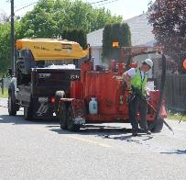
In Videos 1, 2, & 3…
Preservation =
Street Capital Projects Fund #303 and Pavement Preservation Fund #311
Annual funding shortfall of $5 million combined
Maintenance =
Street O&M Fund #101
Annual funding shortfall of $3 million

Slide 18
Key Considerations
The Pavement Management Program is accounted for in three separate Funds.
The Street Capital Projects Fund #303 and the Pavement Preservation Fund #311 account for the Preservation portion of the program.
The Street O&M Fund #101 accounts for the Maintenance portion of the program.
Each of these three funds have funding challenges that need to be addressed.

Slide 19

Streets Sustainability Committee
For more information:
https://www.spokanevalley.org/StreetsCommittee
Adam Jackson, Pavement Management Program Coordinator
509-720-5024
Ajackson@SpokaneValley.org
StreetSolutions@SpokaneValley.org

