Slide 1
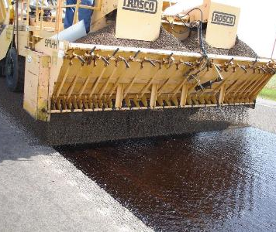
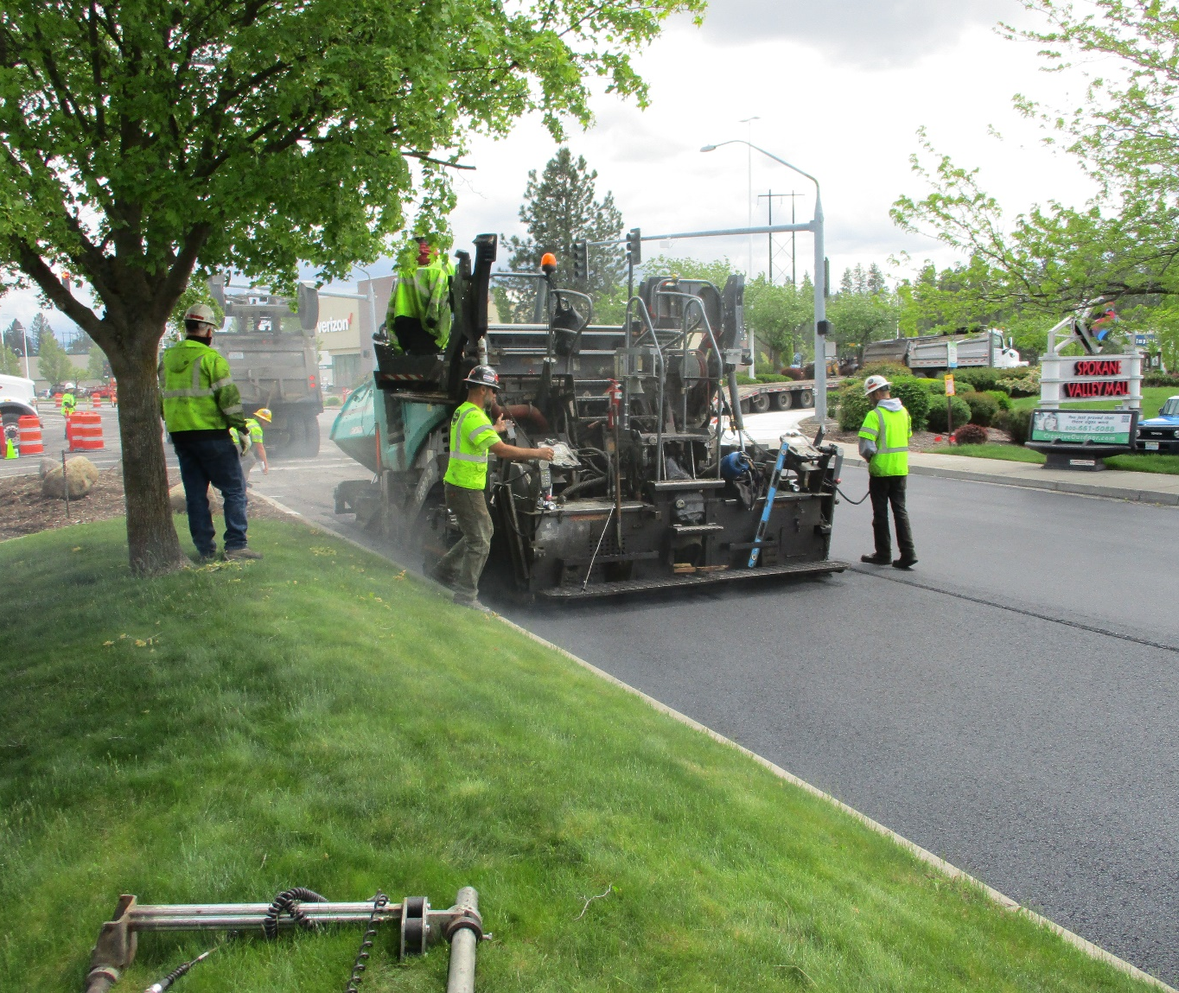
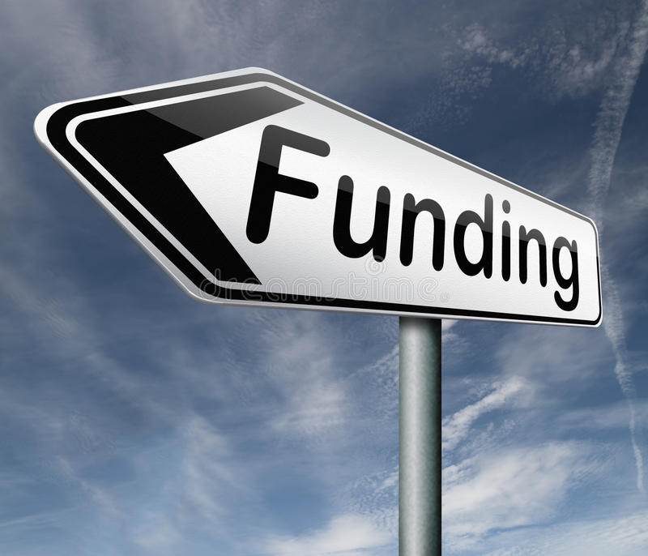
Video #5: Pavement Management Program Funding Options
Streets Sustainability Committee

Slide 2

Why are we talking about funding options?

Slide 3
Summary of Video #4
The Pavement Management Program is accounted for in three separate Funds, or buckets of distinct revenues and expenditures.
The Preservation portion of the Program is accounted for in the Street Capital Projects Fund #303 and the Pavement Preservation Fund #311.
The Maintenance portion of the Program is accounted for in the Street O&M Fund #101.
Collectively in these three funds, there is a funding shortfall of $8 million in order to keep the City’s streets at their current condition.

Slide 4

What options does the City have to raise additional revenues?

Slide 5
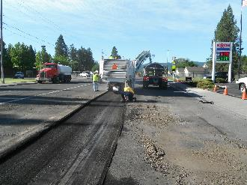
Available Funding Options:
Property Tax Banked Capacity
Levy Lid Lift
Transportation Benefit District
Utility Taxes

Slide 6
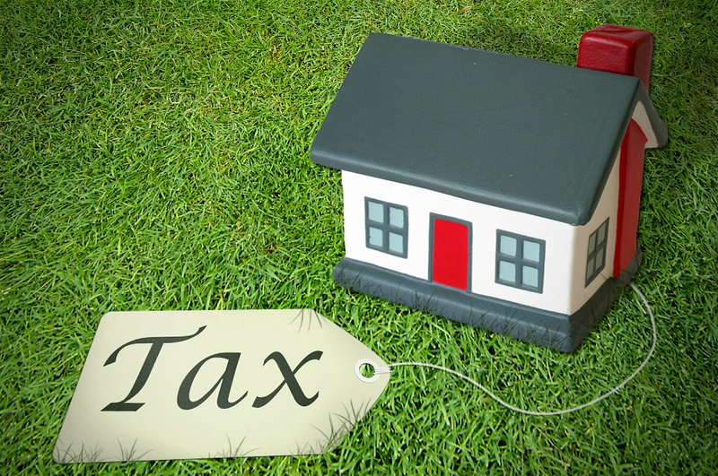
What is property tax banked capacity & what revenues could the City receive?

Slide 7

Property Tax Crash Course
State law limits the maximum property tax rate and also the maximum annual increase of the property tax levy.
Generally the property tax levy cannot increase more than 1% per year, excluding new construction.
Spokane County performs property valuation assessments and calculates the Highest Lawful Levy.
The Highest Lawful Levy is the most the City could assess in property taxes if it had taken the maximum allowed increases each year.

Slide 8
Banked Capacity
Banked capacity is the difference between what the City could levy (the Highest Lawful Levy) and what it actually levies for property tax.
Banked capacity can be accessed by the City through the annual property tax levy ordinance that is adopted by Council.
If the City were to access banked capacity, it would allow an increase of greater than the 1% limit for that year.

Slide 9
Banked Capacity
Accessing banked capacity resets the base upon which the City’s future property tax calculations are made.
The City can’t go back in time and collect the taxes that were left behind.
The City’s banked capacity for 2021 is $878,432.
If the City were to access banked capacity, property taxes would increase by about $7.60 per year for every $100,000 of assessed value.

Slide 10

What is a levy lid lift? How would it increase revenues?

Slide 11
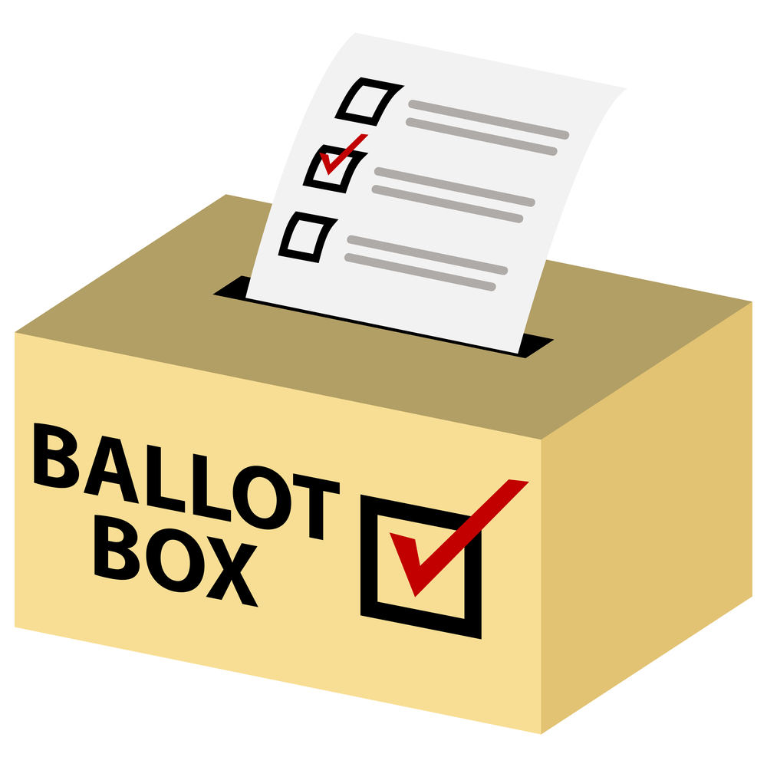
Levy Lid Lift
A levy lid lift is voter approval to increase the jurisdiction’s property tax levy by greater than the 1% limitation.
The ballot measure for a levy lid lift requires a simple majority of voters to pass.
Banked capacity likely must be used prior to using a levy lid lift.
A levy lid lift may be for a restricted period and/or restricted purpose depending on how the ballot measure is stated.

Slide 12
Revenue Implications
An increase of 1% to the property tax levy would be about $136,000 annually.
If the City were to receive voter approval for a levy lid lift, property taxes would increase by about $1.18 per year for every $100,000 of assessed value for every 1% increase in the levy.
An increase of 59% would be required to raise an additional $8 million, and this would exceed legal limits on the property tax rate.

Slide 13

What is a Transportation Benefit District? What revenues are allowed with it?

Slide 14

Transportation Benefit District Formation
A transportation benefit district (TBD) is a separate legal entity.
A TBD may be formed by a city or county by ordinance following a public hearing.
A city or county may assume the powers of a TBD if it has the same boundaries.
Otherwise it must have a separate governing board pursuant to an interlocal agreement.
If the powers of the TBD are assumed, it ceases to be a separate legal entity.

Slide 15
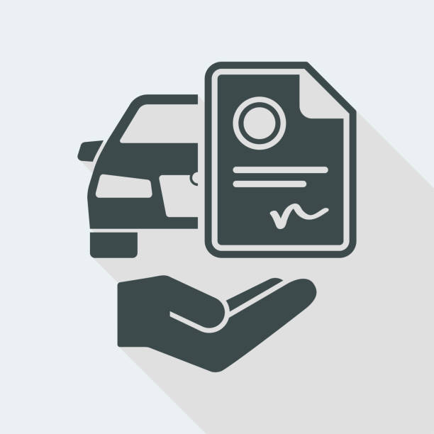

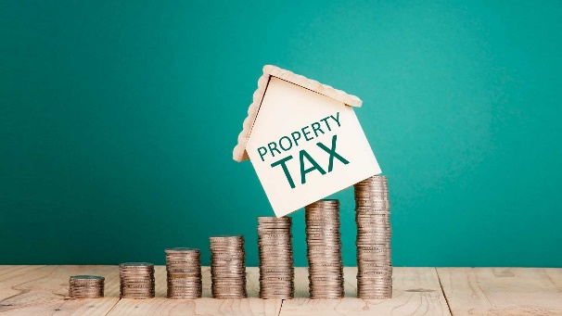
Transportation Benefit District Funding
Revenues collected by a TBD may be used for transportation improvements included in local, regional, or state transportation plans.
Construction, maintenance, and operation costs are eligible.
Primary funding sources for a TBD include:
Vehicle License Fees
Sales Taxes
Property Taxes

Slide 16
Vehicle License Fees
Vehicle license fees of up to $50 may be imposed without a public vote; however, this is limited as follows:
Up to $20 vehicle license fee allowed from formation
Up to $40 vehicle license fee allowed if a $20 fee has been in effect for at least 24 months
Up to $50 vehicle license fee allowed if a $40 fee has been in effect for at least 24 months
Vehicle License fees of up to $100 may be imposed if approved by a simple majority of voters.
Estimated annual revenues from vehicle license fees are as follows:
$1.4 million at $20 fee
$2.9 million at $40 fee
$3.6 million at $50 fee

Slide 17
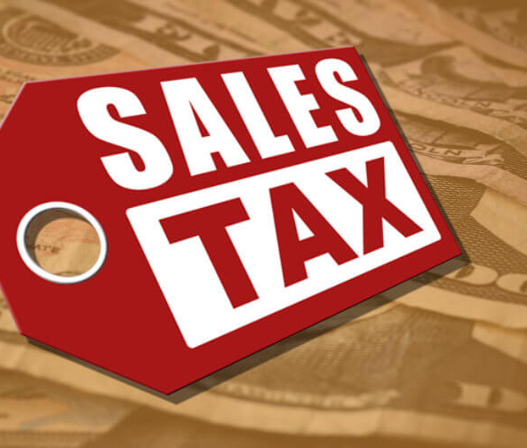
Sales and Use Tax
A TBD may impose a sales and use tax of up to 0.2% for up to 10 years (except to pay for debt service).
This tax must be approved by a majority of voters.
The tax is in addition to any other taxes authorized by law.
The estimated annual revenue from a 0.2% sales and use tax is $5.9 million (based on 2020 gross sales within the City).
Estimate would be $3.3 million at the City’s historic low for sales tax collections (2010).

Slide 18
Excess Property Taxes
A TBD may levy a property tax in excess of the one percent limitation for a one-year period whenever authorized by the voters of the district.
A TBD may pay for the retirement of voter-approved general obligation bonds, issued for capital purposes only, by levying bond retirement property tax levies in excess of the one percent limitation whenever authorized by voters of the district.
An increase of 1% to the property tax levy would be about $127,000 annually.
If the City were to receive voter for an excess levy, property taxes would increase by about $1.10 per year for every $100,000 of assessed value for every 1% increase in the levy.

Slide 19
TBD Comparison to Other Municipalities
Over 100 TBDs have formed throughout Washington
Only five have multiple funding sources (vehicle license fees and sales tax)
Only nine have vehicle license fees above $20, and none are above $40
Per MRSC, the only TBD to have successfully passed a voted vehicle license fee is the Seattle TBD.
However, there are a number of cities that have successfully passed the voted 0.2% sales tax.

Slide 20

What are utility taxes & how much would be available from revenues?

Slide 21
What are utility taxes?
Utility taxes are a form of business and occupation tax on the income of utilities operating in the City.
There are no statutory limitations on the use of utility tax revenues.
Any changes in the tax rate cannot take effect until the end of 60 days after the enactment of an ordinance by the City.

Slide 22
Which utilities may be taxed?
The utility tax rate is limited by state law to 6% (without voter approval) for:
Electricity
Natural gas
Steam
Telephone
The utility tax rate is NOT limited by state law for:
Sewer/Stormwater
Solid waste
Water
Cable television (cannot be discriminatory)

Slide 23
Estimated Utility Tax Revenues

Slide 24
Utility Tax Impact to Average Residential Customer

Slide 25
Utility Tax Comparison to Other Municipalities

Slide 26
Key Considerations
The City has several options for raising additional revenues to support the Pavement Management Program.

Slide 27

Streets Sustainability Committee
For more information:
https://www.spokanevalley.org/StreetsCommittee
Adam Jackson, Pavement Management Program Coordinator
509-720-5024
Ajackson@SpokaneValley.org
StreetSolutions@SpokaneValley.org

